Slide 1
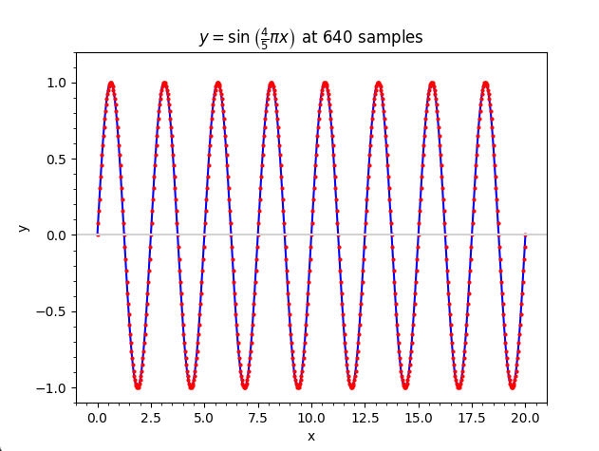
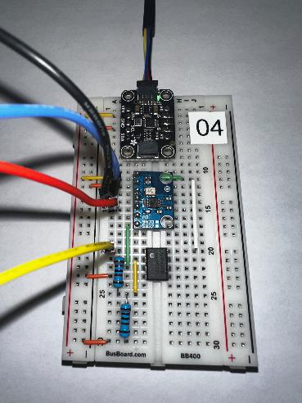
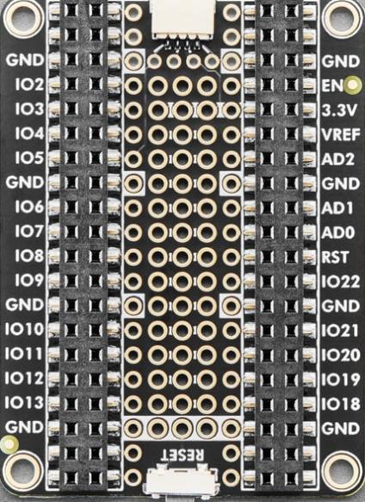
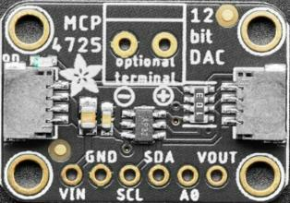
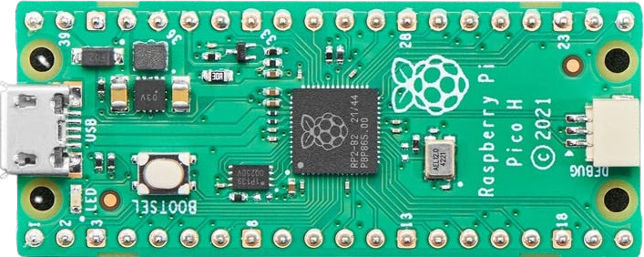
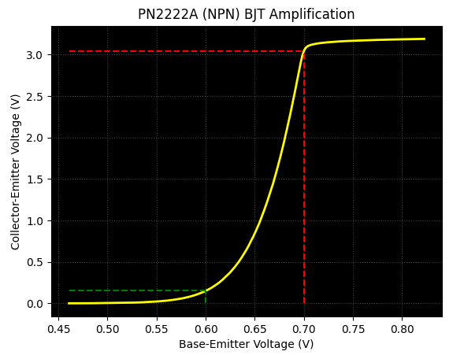

Control System Electronics 101
Using Python and Sensors to Measure Circuits
Board 02
DAC, ADC,
BJT Amplifier
Dave Biersach
dbiersach@bnl.gov

Slide 2
Board 02 – Goals
Compare and contrast an Analog to Digital Converter (ADC) versus a Digital to Analog Converter (DAC)
Measure and plot the small signal gain in an NPN Bipolar Junction Transistor (BJT) (PN2222A) configured in a common emitter circuit
Determine the cutoff, active, and saturation regions for that transistor circuit

Slide 3
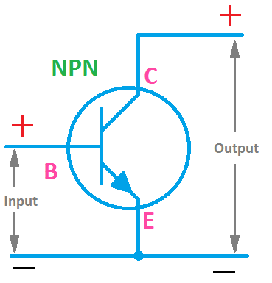
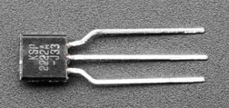
About Transistors
A transistor is an electronic component used in circuits to amplify or switch electrical signals or power. As a simplified model, consider a transistor as consisting of two diodes connected back-to-back
A transistor (BJT) has three terminals: emitter, base, and collector. The basic idea behind a transistor is that it lets you control the flow of current through an output channel (C→E) by varying the intensity of a much smaller current that’s flowing through an input channel (B→E)
Collector collects electrons
Collector
Base
LARGE Current
Emitter
Small Current
PN2222 Transistor (BJT)
Emitter emits electrons

Slide 4
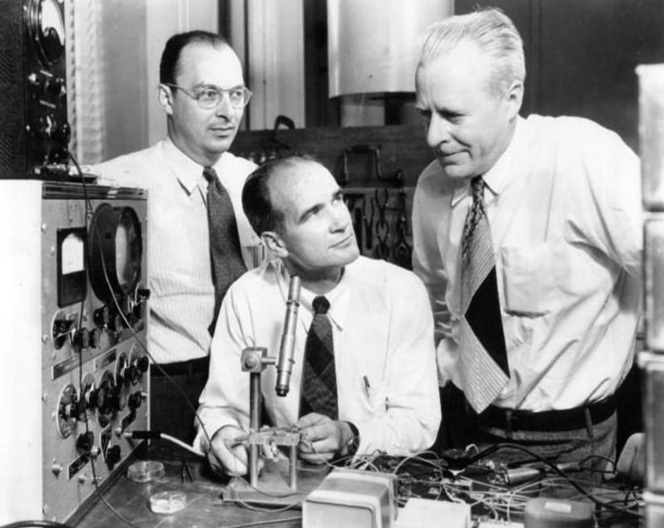
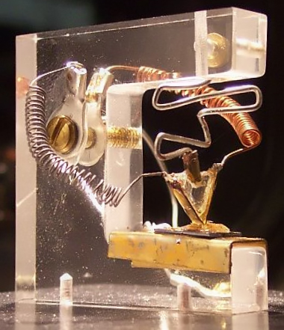
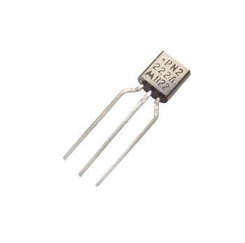
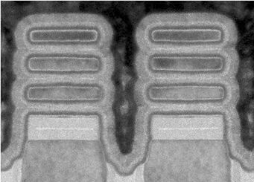
The Bipolar Junction Transistor (BJT)
John Bardeen, William Shockley, Walter Brattain
Bell Labs, 1938
The First Transistor
December 23, 1947
(10 cm, 200 g)
The PN2222A
June 1972
(4mm, 0.2g)
All three shared the
the Nobel Prize in 1956
IBM Transistor
2021
(2 nm,
1.86 x 10⁻²⁰ g)
The physics hasn’t changed,
but the engineering has!

Slide 5
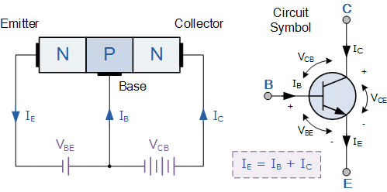
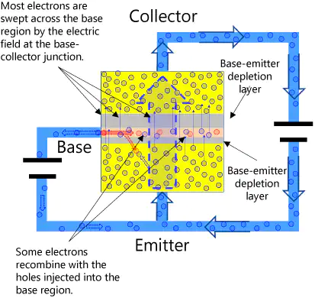
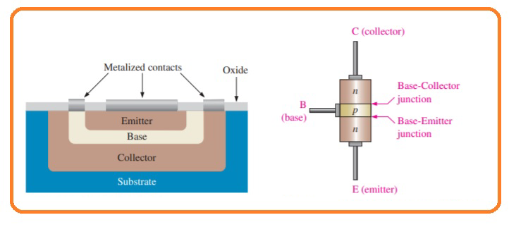
The Bipolar Junction Transistor (NPN)
Try to keep I_{B} , I_{E} , I_{C}
and V_{BE} , V_{CE} clear in your mind for this lab

Slide 6
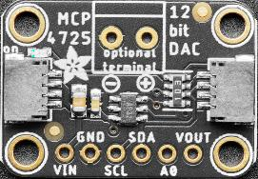
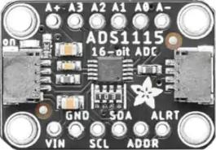
Generating and Reading Precise Voltages
We often need a way to generate precise voltages – so we must use a digital-to-analog (DAC) converter
We often need a way to measure precise voltages – so we must use an analog-to-digital (ADC) converter

Slide 7
Generating and Reading Precise Voltages
The RP2040 does not have a DAC (only an ADC), so we will control the Adafruit MCP4725 12-bit DAC using the I²C protocol
The RP2040 built-in ADC is only 12 bits (4,096 distinct voltage levels), so we will control the Adafruit ADS1115 16-bit ADC using I²C (65,356 distinct voltage levels)

Slide 8
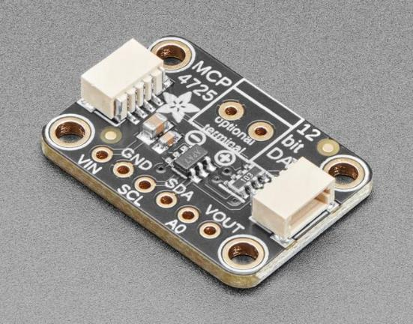
Adafruit MCP4725 - 12-Bit DAC with I²C
https://www.adafruit.com/product/935
$4.95

Slide 9
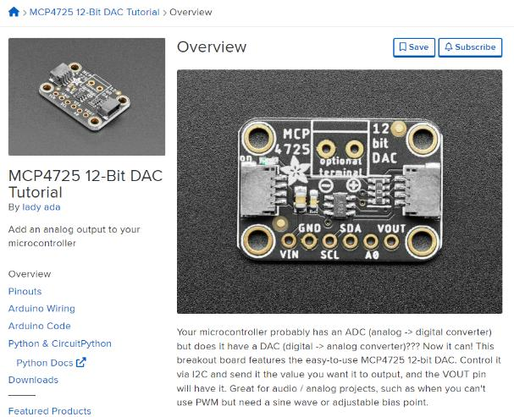
Adafruit MCP4725 - 12-Bit DAC with I²C
https://learn.adafruit.com/mcp4725-12-bit-dac-tutorial/overview

Slide 10
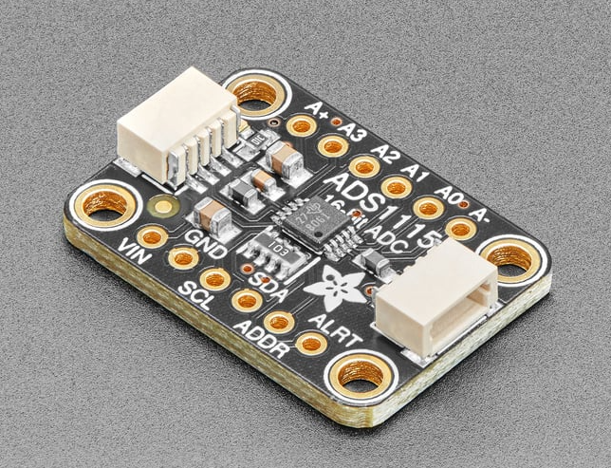
Adafruit ADS1115 - 16-Bit ADC with I²C
https://www.adafruit.com/product/1085
$14.95

Slide 11
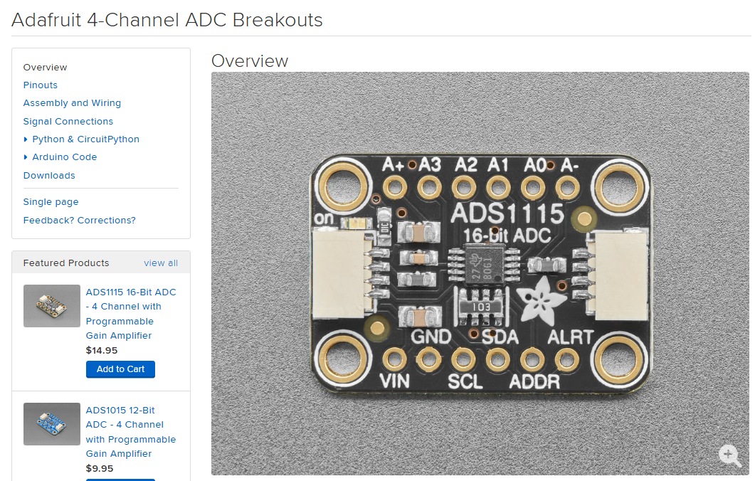
Adafruit ADS1115 - 16-Bit ADC with I²C
https://learn.adafruit.com/adafruit-4-channel-adc-breakouts

Slide 12
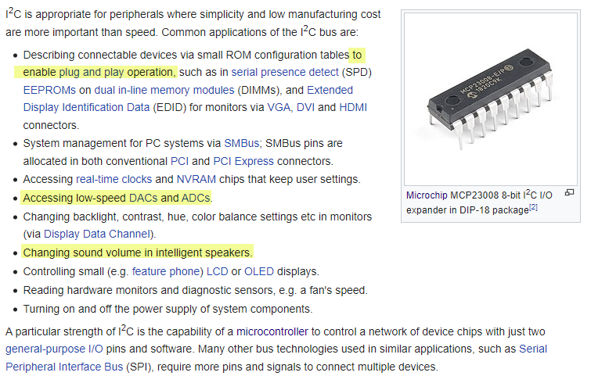
The I²C Bus Protocol
https://en.wikipedia.org/wiki/I²C

Slide 13
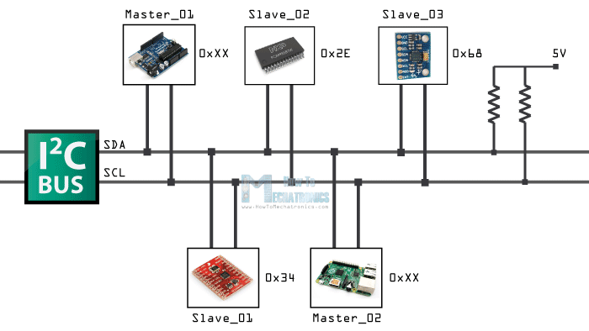
The I²C Bus Protocol
Every device on the bus needs to have a unique address
Controller_01
Peripheral_02
Peripheral_03
SDA = Serial Data
SCL = Serial Clock
The I²C bus only needs two wires
Peripheral_01
Controller_02

Slide 14
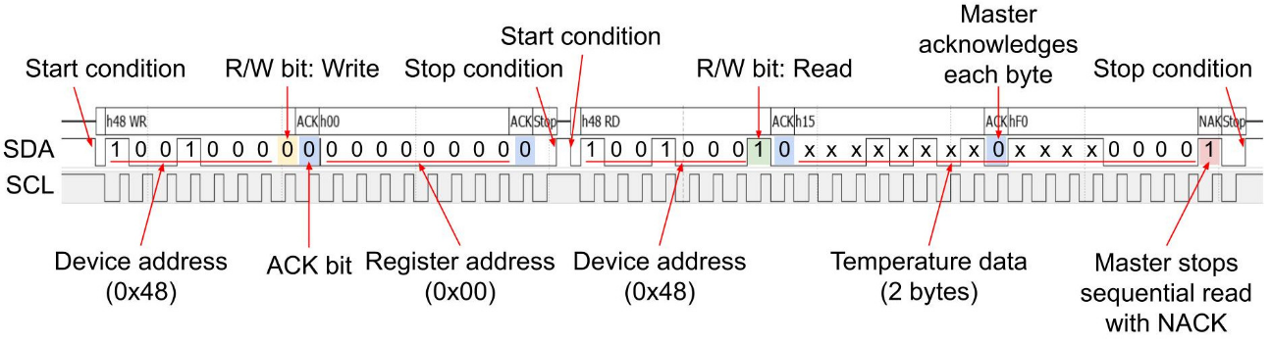
The I²C Bus Protocol
Controller_01
Peripheral_02
Peripheral_03
Peripheral_01
Controller_02

Slide 15
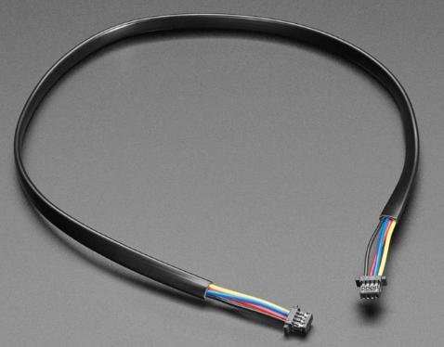
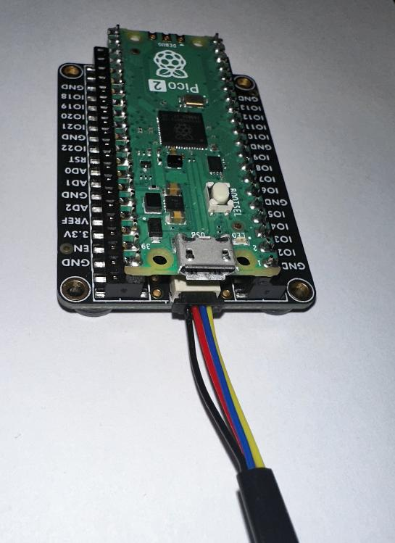
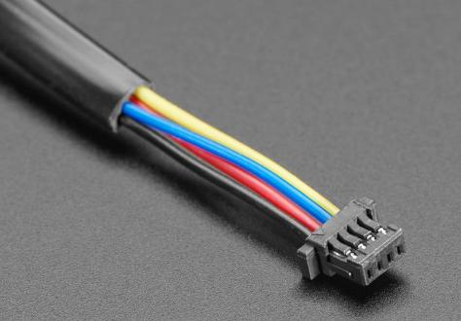
https://www.adafruit.com/product/4401
$1.25
STEMMA QT / Qwiic Cable – 200mm
Carries the I²C signals (and +3.3 V and GND) from the MCU to the board components

Slide 16
The Challenge
Unfortunately, the MCP4725 DAC can output only 14.5 mA of current. This limitation presents two problems:
If we place too small a resistive load on the output of the DAC, too much current will flow out of the DAC, and its output voltage will not properly represent our supplied integer, e.g., given 890, the DAC should output 0.68V, but it will only output 0.37V
If we connect too large a resistive load on the DAC, the small output current will present too small a voltage step for the ADS1115 ADC to measure consistently
We need a way to boost the output current of the MCP4725 DAC
Fortunately, a bipolar junction transistor (BJT) in the common emitter configuration can amplify current

Slide 17

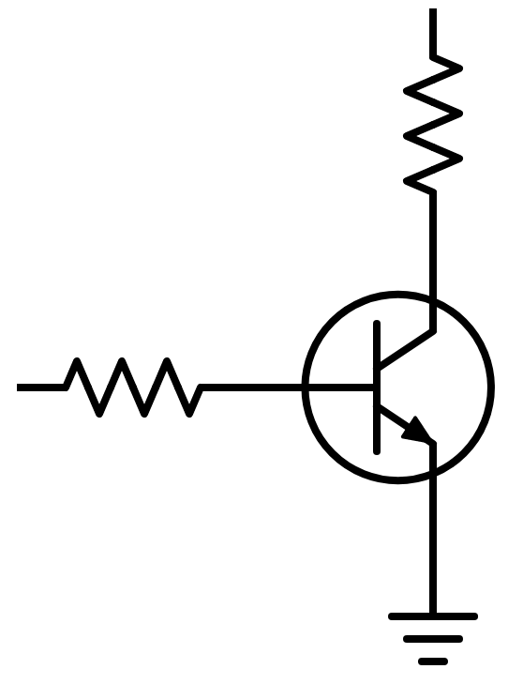

The Bipolar Junction Transistor (NPN)
Vcc = +3.3V
HIGH (A0)
To the ADC
(measures voltage
across the resistor)
1000 Ω
$$V_{R}=I_{C}×R_{C}$$
LOW (A1)
Collector
800mA
(what we want
to give the ADC)
From the DAC
Base
PN2222A NPN BJT
14.5mA
(most we can get from the DAC)
1000 Ω (1K)
A current-limiting resistor is needed to protect the transistor’s silicon
Emitter
GND
Common Emitter Configuration
GND

Slide 18
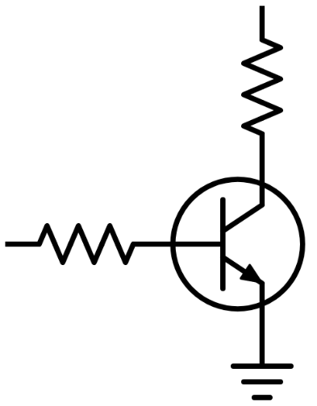
Lab Design
To MCU
All devices on the I2C bus have their respective SDA and SCL pins connected
All Vin and GND pins are connected to the power rails
The Vout pin of MCP4725 DAC ranges voltage (0.45V to +3.3V) into the BASE (V_{BE})
The differential inputs A0 and A1 of the ADS1115 ADC allow measuring the voltage drop across the COLLECTOR resistor (R_{C})
Via Ohm's Law and KCL/KVL, if we know the R_{C} value and the voltage drop across it, we could find the COLLECTOR current (I_{C})
V_{CC} =+3.3V
1KΩ
(R_{C})
C
B
1KΩ (R_{B})
E
0V

Slide 19
Lab Design
We can control the current flowing into the Base by adjusting the voltage at the Base resistor (R_{B}) because, in our circuit, R_{B} has a fixed resistance of 1KΩ
At V_{BE} = 0.0V (I_{B} = 0.0mA), the NPN BJT is "off" and does not allow current to flow into the Collector (I_{C} = 0.0mA)
Once V_{BE} exceeds the cutoff voltage for the transistor (typically 0.6V), the BJT enters its active region
When active, increasing V_{BE} increases I_{B}, which significantly increases I_{C}, which, because the Collector resistor is fixed at (R_{C} = 1KΩ), proportionally increases V_{CE}
In a common emitter model, the output is taken from the Collector pin

Slide 20
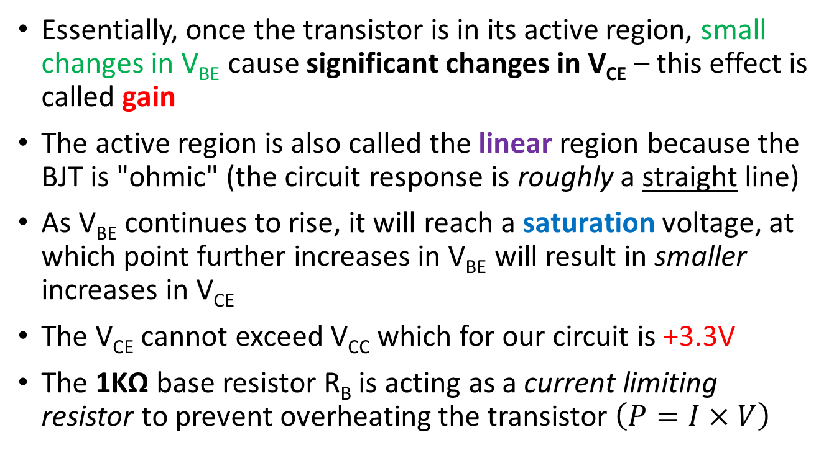
Lab Design
Essentially, once the transistor is in its active region, small changes in V_{BE} cause significant changes in V_{CE} – this effect is called gain
The active region is also called the linear region because the BJT is "ohmic" (the circuit response is roughly a straight line)
As V_{BE} continues to rise, it will reach a saturation voltage, at which point further increases in V_{BE} will result in smaller increases in V_{CE}
The V_{CE} cannot exceed V_{CC} which for our circuit is +3.3V
The 1KΩ base resistor R_{B} is acting as a current limiting resistor to prevent overheating the transistor $\left(P=I×V\right)$

Slide 21
Unplug the MCU before changing any wiring!
As we move between each “experiment” on a given breadboard or switch to an entirely new Board #, it is crucial that you FIRST UNPLUG the USB cord!
I recommend unplugging the cord at the PC end – leave the cord connected to the Micro USB port on the Pico
It is dangerous to change any wiring while the MCU is still drawing power from your laptop’s USB port. (NOTE: We will do this only during this Ohm’s Law lab on Board #3!)
If you incorrectly connect a jumper wire between the Pico and the breadboard while the Pico is drawing power from your PC, you can permanently damage your PC’s USB port
Have your partner double-check your wiring every step!

Slide 22
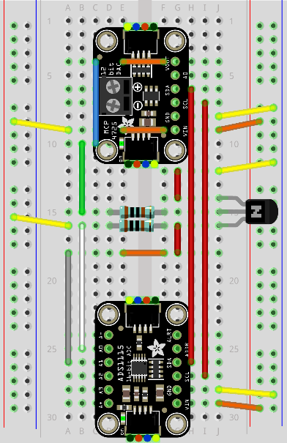
Review Board 02
Board 02 will introduce you to a high-precision DAC and ADC to measure the amplification of an NPN BJT
DAC
Two
1KΩ Resistors
BJT
ADC

Slide 23
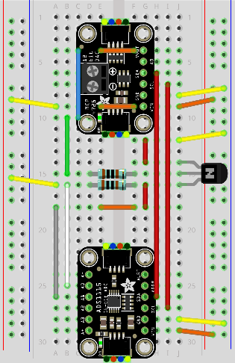
Power Flow (Vcc = +3.3V)
The BJT Collector is tied to +3.3V (Vcc), and the 1KΩ resistor limits the current to protect the transistor when it is fully saturated

Slide 24
Power Flow (GND)
In this circuit, the BJT Emitter pin is tied to GND

Slide 25
DAC Current Output
The DAC output feeds the Base of the NPN BJT so that it can control the Collector (output) current of the BJT
The 1KΩ resistor limits the Base current to protect the transistor

Slide 26
I²C Bus Communication (Clock - SCL)

Slide 27
I²C Bus Communication (Data - SDA)

Slide 28
BJT Collector Current Output
We measure the voltage drop in the current flowing out of the BJT Collector as it passes through the resistor
In the Common Emitter configuration, we take the BJT output from the Collector pin

Slide 29
BJT Collector Current Output
In the Common Emitter configuration, we take the BJT output from the Collector pin
The ADC input will measure the voltage differential before and after the resistor

Slide 30

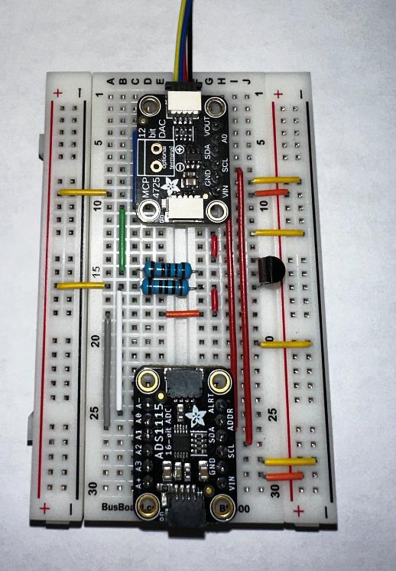
Wire Your Pico to Board 02
Gently ensure the Qwiic cable is fully inserted
The Qwiic cable is like a USB Type-A plug – it only fits in the Qwiic jack one-way

Slide 31
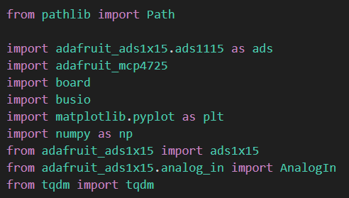
Open bjt_amplification.py
①
②
③
④

Slide 32
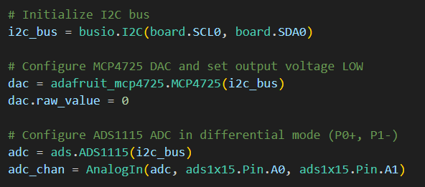
View bjt_amplification.py
①
②
③

Slide 33
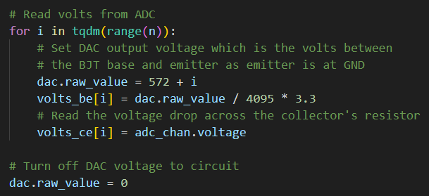
View bjt_amplification.py
①
②
③
④
⑤

Slide 34
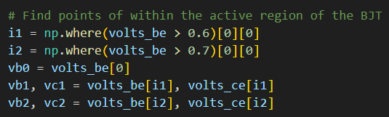
View bjt_amplification.py
①
②
③
④

Slide 35

View bjt_amplification.py
①
②
③
④

Slide 36
Connect the Pico to Your PC
If you incorrectly connect a jumper wire between the Pico and the breadboard, you can permanently damage your PC’s USB port!
Have your partner double-check your wiring before you plug in the USB cable back into your PC

Slide 37
Run bjt_amplification.py

Slide 38
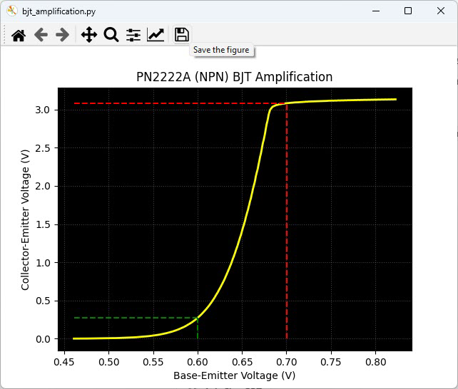
Run bjt_amplification.py
A small change in V_{BE} (0.1V) results in a large change in V_{CE} (2.84V)

Slide 39
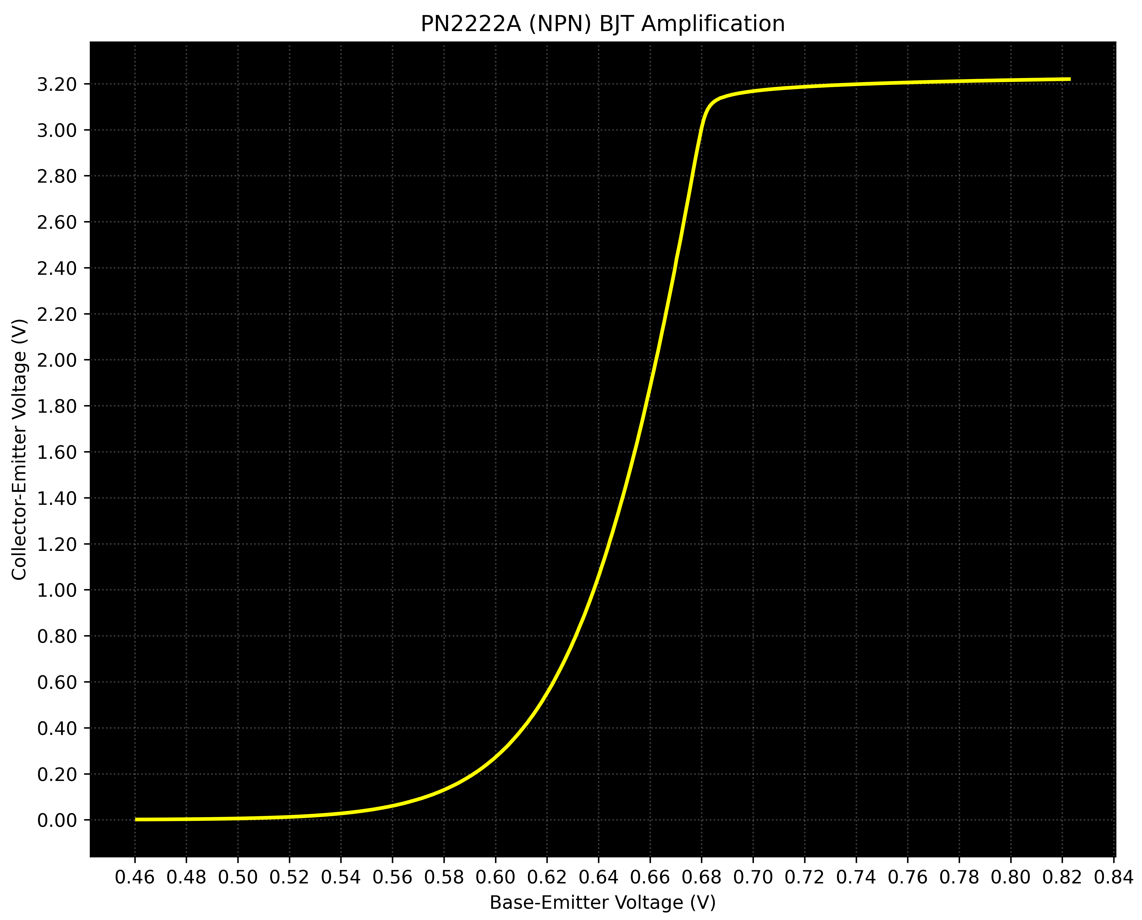
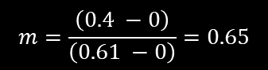

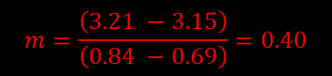
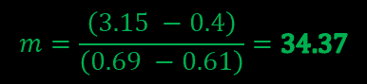
Check bjt_amplification.py
$$m=\frac{\left(3.21 −3.15\right)}{\left(0.84 −0.69\right)}=0.40$$
Saturation Region
$$m=\frac{\left(3.15 −0.4\right)}{\left(0.69 −0.61\right)}=34.37$$
Active Region
In the active region, a slight increase in Base-Emitter voltage results in a significant increase in Collector-Emitter voltage
$$Slope=\frac{rise}{run}=\frac{dy}{dx}$$
$$m=\frac{\left(0.4 −0\right)}{\left(0.61 −0\right)}=0.65$$
Cutoff Region

Slide 40

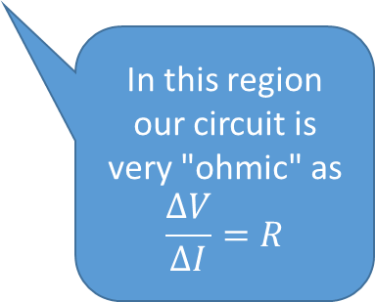
Check bjt_amplification.py
A transistor doesn't amplify a signal by changing that signal.
A transistor creates an entirely separate (2nd) signal that exactly copies the shape of the 1st signal.
But that 2nd signal has a much higher current than the 1st signal, so we appear to amplify the 1st signal.
In this region our circuit is very "ohmic" as
$$\frac{ΔV}{ΔI}=R$$
When the first signal is sent through the Base, the second signal output at the Collector is often 100x stronger!

Slide 41

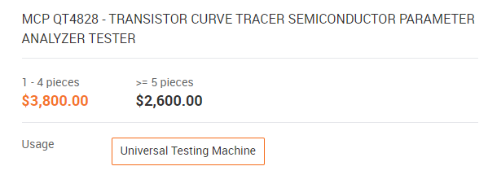

The Value of Knowing How to Code
$$\$5.00$$

